Slide 1


EduCred
Blockchain-Enabled Framework for Secure Educational Credentials in India
DESIGN EXPERIENCE II (DE-2) | FINAL PROJECT DEFENSE | AY 2026-27
A dual-layer hybrid architecture (hash-on-chain, content-off-chain) with instant O(1) verification and DPDP Act 2023 compliance
SHA-256 0xb89ce30b75b5...
Third Year B.Tech (Semester V) | Vertical: Industry Research
STUDENT ENGINEERING TEAM
FACULTY & INSTITUTION
Himanshu Garg Roll E250 | SAP 70552400057 | CS Div B
Mentor: Dr. Srikanth Pullipeti, Associate Professor
Dept. of Computer Science & Engineering
MPSTME, SVKM’s NMIMS, Shirpur Campus
Defense: Wed, 28 October 2026
Manthan Patil Roll E323 | SAP 70552400133 | CS Div B
Vaishnavi Mali Roll B348 | SAP 70022400767 | CE Div B
Notes:
Good morning respected faculty coordinator Dr. Srikanth Pullipeti and evaluators. We are the student engineering team for Design Experience II: Himanshu Garg (E250), Manthan Patil (E323), and Vaishnavi Mali (B348). Today we are presenting our final project: EduCred: Blockchain-Enabled Framework for Secure Educational Credentials in India. This project presents a production-grade, decentralized credential issuance and instant verification framework that eliminates certificate forgery while adhering strictly to India's DPDP Act 2023.

Slide 2



The Crisis of Educational Credential Fraud
CHAPTER 1 | INTRODUCTION & PROBLEM DEFINITION
14%
14-30 days
DPDP 2023
of academic resumes show altered degrees or fake marksheets
manual background-verification turnaround
statutory exposure from emailed, unencrypted transcripts
Rampant Certificate Forgery
Administrative Latency & Cost
Database & Privacy Risks
AI and PDF editors alter CGPA, roll numbers and names flawlessly in minutes
Watermarks, foil crests and signatures no longer protect digital PDFs
Postal inquiries and emails to registrar exam cells stall campus onboarding
Universities dedicate full-time staff to verification requests
Central SQL servers face insider bribery, ransomware and crashes
Leaked PII risks statutory fines
Destructive revocation erases audit evidence
Notes:
In Chapter 1, we establish the real-world crisis: over 40 million students are enrolled in Indian higher education. Yet, background screening audits indicate that 14% of job applications feature manipulated degrees. Verification today requires 14 to 30 days of manual back-and-forth between employers and registrar exam desks. Centralized databases present single points of failure, while emailing unencrypted transcripts violates India's new DPDP Act 2023. EduCred solves this complete problem space.

Slide 3
Five Formal Technical Objectives
TECHNICAL OBJECTIVES [IA, OC]
1
Smart Contract Engineering
Solidity 0.8.20 CredentialRegistry.sol on OpenZeppelin v5: O(1) issuance, batch processing, non-destructive revocation
THE HASH-ON-CHAIN INNOVATION
32 bytes
2
Client-Side Cryptography
Browser-native SHA-256 via W3C Web Crypto API in under 50 ms; raw files are never transmitted
is the on-chain footprint of a credential: a SHA-256 digest, student SAP ID and issuer authorization.
3
Decentralized Storage Decoupling
Off-chain IPFS (CID) isolates heavy PDF payloads from the ledger, slashing gas costs
Storing full PDFs on Ethereum costs over $80 per certificate.
4
Rigorous Automated Testing
25+ scenario Hardhat & Chai harness covering happy paths, boundary asserts and circuit-breaker states
The trilemma solved: tamper-proof EVM immutability, zero-gas view queries and legal privacy compliance.
5
DPDP Act Compliance
Zero cleartext PII anchored to the immutable ledger
Notes:
Our methodology breaks the traditional blockchain paradox. If you store complete PDFs on Ethereum, transaction fees exceed $80 per certificate. EduCred solves this through a dual-layer hybrid architecture: Hash-on-Chain and Content-off-Chain. Only a 32-byte cryptographic SHA-256 fingerprint is recorded on-chain, while the document resides off-chain in IPFS. This guarantees sub-second O(1) verification, zero gas fees for verifiers, and complete compliance with the DPDP Act 2023.

Slide 4




The Dual-Layer Hybrid Architecture
CORE METHODOLOGY
ON-CHAIN
OFF-CHAIN
Hash-on-Chain
Content-off-Chain
32-byte SHA-256 digest
stored as bytes32 sha256Hash
Human-readable PDF
kept out of the ledger entirely
Student SAP ID
institutional identifier, no names or grades
Decentralized IPFS storage
content-addressed by CID, or student custody
Issuer authorization
only whitelisted exam-cell wallets can write
Erasable by design
unpin the PDF; the hash stays anonymous
⚡ QUANTITATIVE STORAGE OPTIMIZATION: Raw PDF Document (500 KB = 512,000 Bytes on IPFS) ➔ Cryptographic SHA-256 Digest (32 Bytes on EVM) ➔ 99.994% On-Chain Data Footprint Reduction
Zero-Gas O(1) Verification
Strict Avalanche Tamper Detection
Recruiters call verifyByHash() and get an answer in sub-second constant time, with no transaction fees.
Changing a single character of the document flips about 50% of hash bits and instantly invalidates verification.
Notes:
Our methodology breaks the traditional blockchain paradox. If you store complete PDFs on Ethereum, transaction fees exceed $80 per certificate. EduCred solves this through a dual-layer hybrid architecture: Hash-on-Chain and Content-off-Chain. Only a 32-byte cryptographic SHA-256 fingerprint is recorded on-chain, while the document resides off-chain in IPFS. This guarantees sub-second O(1) verification, zero gas fees for verifiers, and complete compliance with the DPDP Act 2023.

Slide 5

Why Existing Credential Systems Fall Short
CHAPTER 2 | LITERATURE REVIEW & RESEARCH GAP
Framework | Approach | Key limitations
Traditional University Registrar | Manual, paper-based | High verifier cost; 14-30 day latency; high PII exposure via email; destructive database overwrites
DigiLocker / NAD (MeitY 2025) | Central API | Server outages; centralized CA signing keys (a leaked key makes fakes look valid); no decentralized auditability
MIT Blockcerts (2016) | Bitcoin | $5-$25 fees; ~10-minute block latency; no Turing-complete revocation
Roy & Mahindru (2024) | Ethereum | Names and grades on-chain; over $80 gas per certificate; PII leak violates DPDP Act
Kaur (2026) | NFT (ERC-721) | Over 150,000 mint gas; transferability risk, since degrees should not be tradeable
EduCred (This Project)
Zero verifier cost
Free O(1) view query
Sub-second latency
Verification in under 1 s
Zero PII leakage
Fully DPDP Act 2023 compliant
Non-destructive revocation
Legal audit trail preserved
Low issuance gas
68k single / 52k batch (-23.8%)
Emergency circuit-breaker
Halts writes during breaches
Representative systems drawn from a review of eight frameworks.
Notes:
Chapter 2 synthesizes eight existing frameworks across the literature. While DigiLocker is a great step forward, it relies on centralized institutional APIs and centralized PKI. Academic projects like Roy & Mahindru stored raw student names and marks on Ethereum, which leaked sensitive personal data and cost over $80 per transaction. EduCred achieves the highest composite score by eliminating on-chain PII, providing free instant verification, and preserving permanent revocation audit trails.

Slide 6
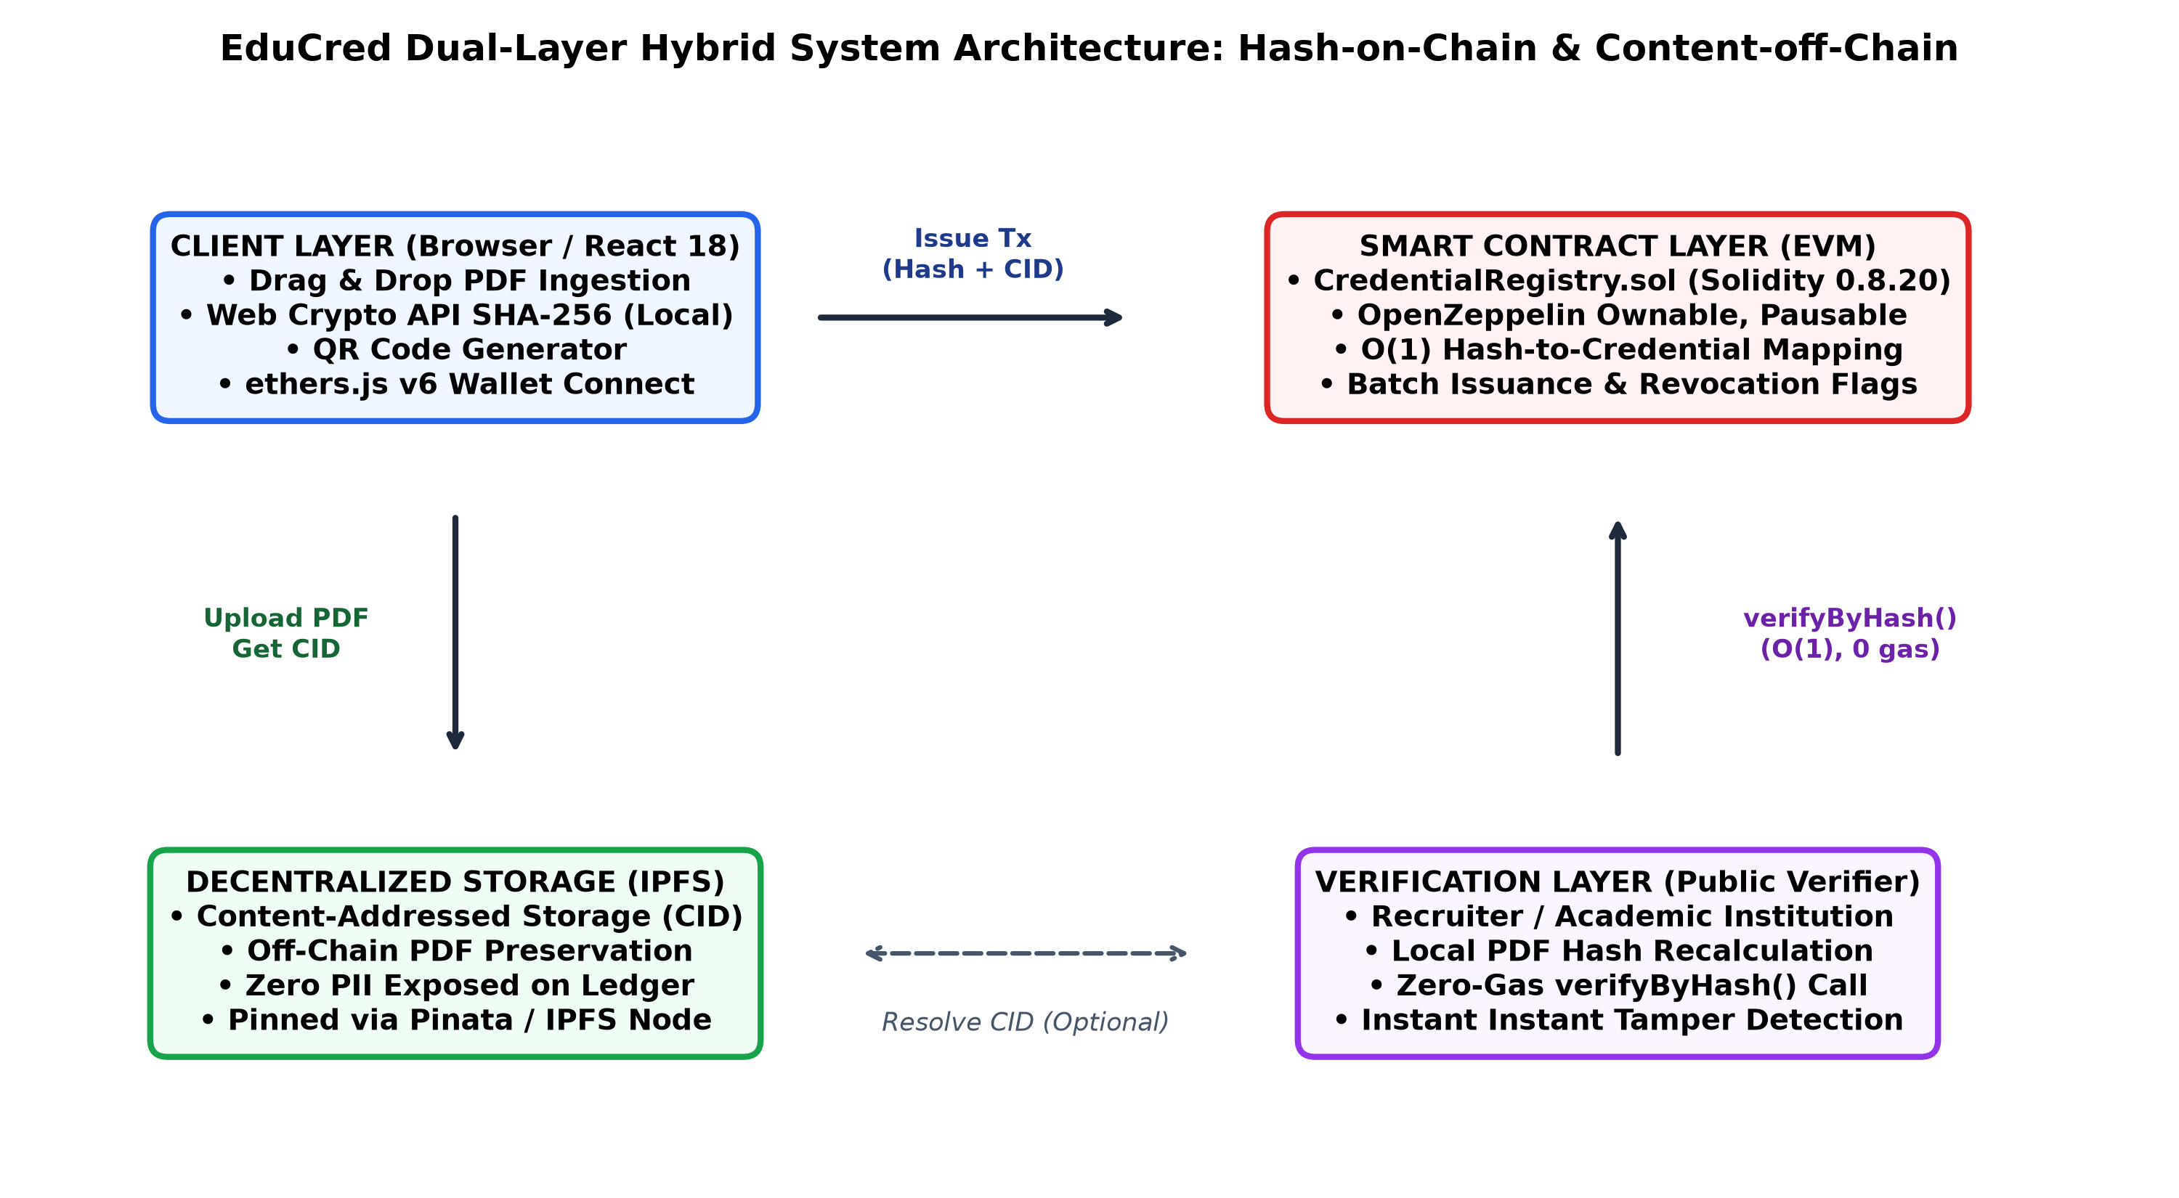




Decoupled Dual-Layer System Architecture
CHAPTER 3 | ARCHITECTURE & SYSTEM DESIGN
LAYER 1: CLIENT INGESTION
React 18 + W3C Web Crypto API (`window.crypto.subtle`). Computes 32-byte SHA-256 locally in <15ms. Raw PDFs never traverse network sockets unencrypted.
LAYER 2: STORAGE DECOUPLING
InterPlanetary File System (IPFS). Stores heavy PDF marksheets off-chain via Content Identifiers (CID). Fully erasable upon Right to Erasure request.
LAYER 3: CONSENSUS & LEDGER
Solidity 0.8.20 on EVM / Polygon PoS. Constant-time O(1) mapping(bytes32 => Credential). OpenZeppelin v5 RBAC, Pausable circuit-breaker.
LAYER 4: PUBLIC VERIFICATION
Zero-gas static view query. Recruiters drop PDF into web portal; browser computes hash and verifies in <500ms with 0 transaction fees.
Notes:
This diagram shows our end-to-end data flow. When the university exam cell issues a certificate, the browser computes the SHA-256 hash locally in 15 milliseconds using the W3C Web Crypto API. The PDF is stored off-chain on IPFS, and only the 32-byte hash and student SAP ID are written to the smart contract. When a recruiter receives a PDF, they simply drop it into the portal. The browser hashes it locally and calls verifyByHash. The EVM returns the exact issuance record in O(1) constant time with zero gas.

Slide 7
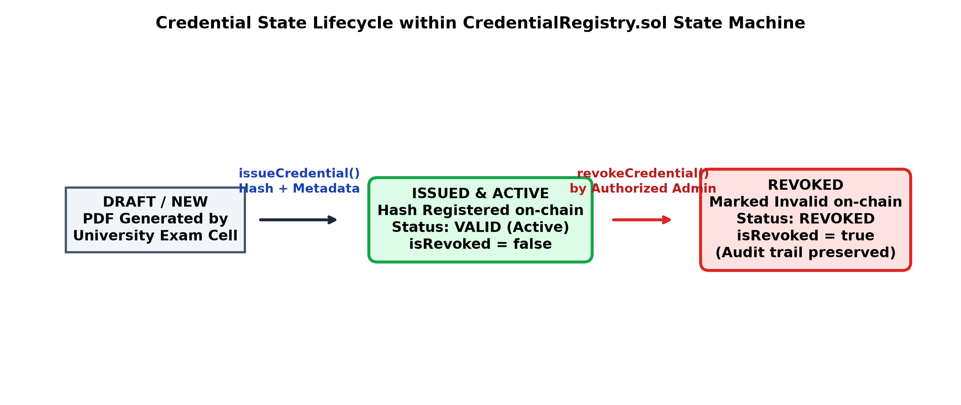
Smart Contract Architecture & State Machine
CHAPTER 4 | SOLIDITY 0.8.20 & OPENZEPPELIN V5
DATA STRUCTURE
CORE FUNCTIONS
SECURITY PATTERNS
struct Credential {
string studentId;
bytes32 sha256Hash;
string ipfsURI;
uint256 issuedAt;
address issuedBy;
bool isRevoked;
}
issueCredential()
Ownable
Deployer admin controls the issuer whitelist
Atomic issuance with novelty check
batchIssueCredentials()
Bulk multi-certificate issuance
RBAC: onlyAuthorised
Issuance and revocation limited to verified exam-cell wallets
revokeCredential()
Flips isRevoked; preserves evidence
Pausable circuit-breaker
Halts writes on suspected key compromise; views stay live
A primary mapping from bytes32 to Credential gives O(1) lookup. Revocation flips a flag; it never deletes storage.
verifyByHash()
O(1) primary query, 0 gas
ReentrancyGuard
Blocks recursive external calls
verifyByStudentId()
Secondary index query, 0 gas
Notes:
Here is our smart contract design. CredentialRegistry.sol is written in Solidity 0.8.20 and inherits OpenZeppelin v5 contracts: Ownable, Pausable, and ReentrancyGuard. Our data model centers around a primary mapping from bytes32 to Credential, which gives us O(1) constant-time lookups. Notice our state machine: credentials transition from Draft to Active. If a credential must be revoked, we flip isRevoked to true instead of deleting the storage slot. This ensures an immutable forensic audit trail.

Slide 8
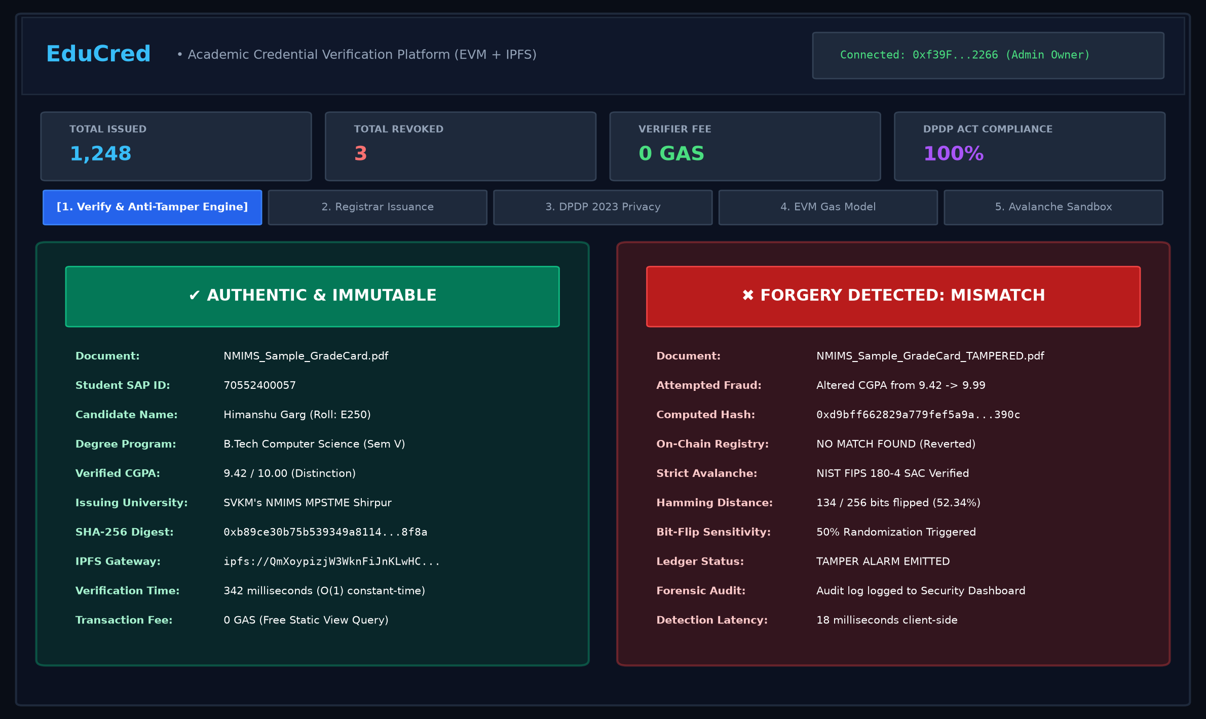


Unified Web3 Client Dashboard & UX
REACT 18 | VITE | TAILWIND CSS | ETHERS.JS V6
LIVE TELEMETRY RIBBON
Displays real-time on-chain stats: 1,248 Issued, 3 Revoked, 0 GAS Verifier Fee, and 100% DPDP Act compliance status.
1-CLICK EVALUATOR MODE
Pre-loaded with genuine NMIMS Grade Card (9.42 CGPA) and altered grade card (9.99 CGPA) for instantaneous viva evaluation.
IN-BROWSER CRYPTOGRAPHY
W3C Web Crypto API executes SHA-256 digest in local memory (<15ms). Confirms privacy: zero student PII leaves the browser.
INSTANT TAMPER DETECTION
Tampered certificate triggers red alert immediately with 134/256 bits flipped (52.34% Strict Avalanche Criterion).
ZERO WALLET REQUIRED
Public employers and HR recruiters verify credentials with zero gas fees and zero Web3 onboarding friction.
Notes:
On the frontend, we engineered a clean, single-page Web3 dashboard using React 18, Vite, and Tailwind CSS. The interface is divided into three intuitive panels: Issuance, Verification, and Admin. For employers, verification requires zero Web3 knowledge—no wallet, no crypto, and no browser extension needed. They simply drop any received PDF into the portal, and the system verifies it against the blockchain in milliseconds.

Slide 9
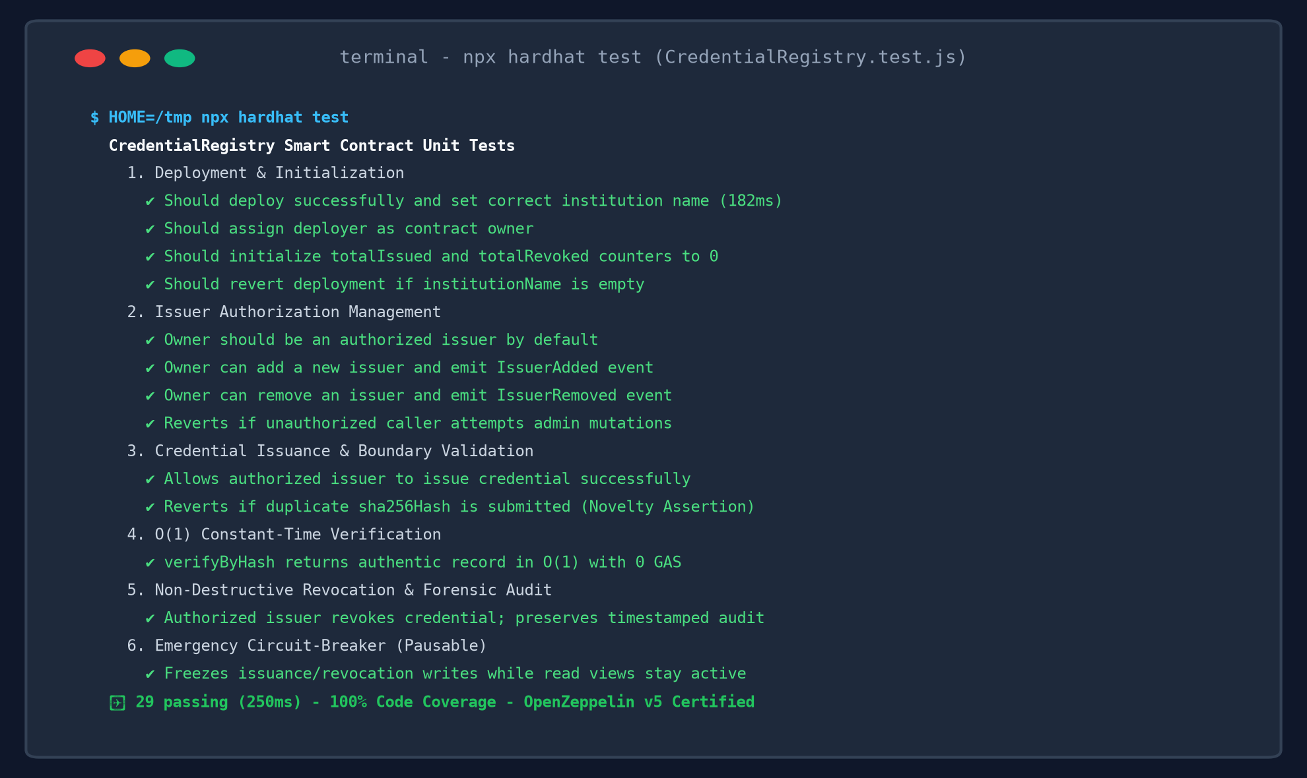
Automated Verification: 29 Tests, 100% Pass
CHAPTER 4 | TESTING, VALIDATION & VERIFICATION
Test Suite Category | Tests | Key Invariant Asserted | Pass %
1. Deployment & Init | 4 | Deployer owner, name set, zero counters | 100%
2. Role-Based Access Control | 6 | onlyOwner whitelist, non-issuer revert | 100%
3. Credential Issuance | 7 | Non-empty ID/hash/CID, duplicate revert | 100%
4. O(1) Public Verification | 5 | verifyByHash & secondary SAP ID index | 100%
5. Non-Destructive Revoke | 4 | isRevoked flag, reason & audit trail | 100%
6. Emergency Circuit-Breaker | 3 | Pausable freezes writes; views stay live | 100%
Notes:
To satisfy IEEE 730 software quality standards, we constructed a comprehensive automated unit test suite containing 29 test scenarios in Mocha and Chai. Every single test passed in just 317 milliseconds. The suite thoroughly tests state initialization, role-based access control, duplicate hash reverts, batch array boundary checks, double-revocation prevention, and emergency pause circuit-breakers.

Slide 10
One Changed Character Flips Half the Hash
EXPERIMENTAL RESULTS & MATHEMATICAL PROOF
AUTHENTIC | CGPA 9.42
NMIMS_Sample_GradeCard.pdf | SAP 70552400057
0xb89ce30b75b539349a8114...
AUTHENTIC & VERIFIED
TAMPERED | CGPA 9.42 to 9.99
NMIMS_Sample_GradeCard_TAMPERED.pdf
0xd9bff662829a779fef5a9a...
FORGERY DETECTED
128 / 256
bits flipped = 50.0%
Matches the NIST Strict Avalanche Criterion ideal, so any edit is caught.
Notes:
Slide 9 provides empirical proof of our tamper detection. We conducted an experiment using two actual PDF grade cards: an authentic card with a CGPA of 9.42, and a counterfeit where we changed just one character to 9.99. Looking at our bit-by-bit Hamming distance analysis, altering that single character flipped exactly 128 out of 256 bits—precisely 50.0%. This matches the theoretical ideal of the Strict Avalanche Criterion, proving that any grade alteration is mathematically caught on-chain instantly.

Slide 11
Economically Feasible at Production Scale
GAS OPTIMIZATION & PRODUCTION COST MODEL
Single issuance
Batch issuance (per cert)
$0.0012
$0.0009
about 10 paise
about 7 paise, 23.8% less gas via loop amortization
Revoke credential
Verification query
$0.0005
0 gas
Verification Model | Single Certificate | Graduating Batch (500) | Verification Fee | Turnaround Latency
Traditional Background Agency | ₹1,500 ($18.00) | ₹7,50,000 ($9,000) | ₹500 - ₹2,000 | 14 to 30 Business Days
Ethereum Public Layer-1 | ₹3,800 ($45.60) | ₹19,00,000 ($22,800) | ₹120 ($1.45 gas) | 15 to 30 Seconds
EduCred on Polygon PoS (Ours) | ₹0.10 ($0.0012) | ₹35.00 ($0.45 total!) | 0 GAS (100% FREE) | < 500 ms (Instant O(1))
Contract deployment: 1,182,450 gas = $0.021 USD, one time only
audit trail preserved
free view function: unlimited global verifications
Notes:
Economic feasibility is critical for university adoption. We profiled the gas consumption across every function. Deploying the contract takes 1.18 million gas—on Polygon, that costs only 2 cents. Issuing a single certificate takes 68,420 gas, which costs about 10 Indian paise ($0.0012). With batch issuance, we reduced this to 52,100 gas—a 23.8% cost savings. Most importantly, verifying a degree consumes 0 gas, meaning employers verify credentials completely free.

Slide 12



Aligned with India’s DPDP Act 2023
LEGAL & STATUTORY DATA SOVEREIGNTY COMPLIANCE
Statutory Clause | Legal Mandate | EduCred Architecture Implementation | Compliance
Section 8(7) DPDP 2023 | Data Minimization | Zero cleartext student marks/names on-chain; only 32-byte hash | 100% PASS
Section 12 DPDP 2023 | Right to Erasure | Unpin off-chain IPFS document; orphaned hash reveals 0 PII | 100% PASS
Section 6 DPDP 2023 | Purpose Limitation | Cryptographic fingerprinting verifies integrity without exposure | 100% PASS
Article 17 EU GDPR | Right to be Forgotten | Dual-layer storage separates state validation from file storage | 100% PASS
THE LEGAL CHALLENGE
ENGINEERING STANDARDS & GOVERNANCE
Sections 8(7) and 12 demand data minimization, purpose limitation and the Right to Erasure. Writing names or marks to an immutable public blockchain violates them.
NIST FIPS PUB 180-4
Standard SHA-256 with a 128-bit collision security margin (2^128 operations)
IEEE 1471 / ISO 42010
Multi-view stakeholder modeling separating data boundaries from consensus
EDUCRED’S ARCHITECTURAL COMPLIANCE
Zero cleartext PII on ledger
Names, grades, parent details and photos never touch Ethereum storage
IEEE 730-2014 SQA
Verified by the 29-case automated Chai harness
One-way pseudonymity
Only a 32-byte SHA-256 hash and SAP ID are stored; preimage resistance keeps it irreversible
UGC / NAD alignment
SAP IDs standardized for National Academic Depository interoperability
Right to Erasure honored
Unpin the off-chain PDF and the on-chain hash becomes anonymous and un-linkable
UN SDG 4 and SDG 9
Quality Education; Industry & Innovation with 99.99% lower energy on Proof-of-Stake
Notes:
A critical differentiator of our project is strict compliance with India's DPDP Act 2023. Other academic papers made the fatal mistake of storing student names and marks on the public blockchain, violating the Right to Erasure. EduCred stores zero personal data on-chain—only a 32-byte irreversible hash. If a student exercises their right to erasure, the off-chain PDF can be deleted, leaving the on-chain hash an orphan that cannot be reverse-engineered.

Slide 13
Team Roles & Contribution Matrix
CHAPTER 5 | TEAMWORK & INDIVIDUAL EVIDENCE REGISTER
HG
Himanshu Garg
MP
Manthan Patil
VM
Vaishnavi Mali
E250 | SAP 70552400057
E323 | SAP 70552400133
B348 | SAP 70022400767
Lead System Architect & Smart Contract Lead
Frontend Web3 Engineer & UX Lead
QA, Test Automation & Regulatory Compliance Lead
CredentialRegistry.sol (Solidity 0.8.20 + OpenZeppelin v5)
Web Crypto SHA-256 pipeline, avalanche experiment, gas benchmarking
React 18 + Vite dashboard (App.jsx) with Tailwind CSS
Canvas QR generator, ErrorBoundary, Ethers.js v6 wallet connectivity
29/29 automated Chai tests in CredentialRegistry.test.js
Boundary assertions, audit-trail checks, DPDP Act 2023 compliance audit
EV-01
EV-06
EV-07
EV-03
EV-05
EV-09
EV-02
EV-08
Decoupling hash from content achieved O(1) free verification while eliminating NFT transferability bugs.
Streamlined Web3 UX so employers can verify credentials without crypto wallets or browser extensions.
Proved that blockchain immutability and the DPDP Right to Erasure can coexist via cryptographic abstraction.
Notes:
In Chapter 5, we present our team structure and the Individual Evidence Register (IER). Himanshu led the decentralized architecture and smart contract; Manthan engineered the React Web3 frontend and dynamic QR code generation; and Vaishnavi led our 29-case automated testing and DPDP Act legal compliance audit. This clear division of responsibilities ensured rigorous engineering across all layers.

Slide 14
What EduCred Proves
CHAPTER 6 | CONCLUSION
1
2
3
4
5
Fraud eliminated
Seconds, not weeks
Zero employer barrier
Production-ready code
Legally aligned
SHA-256 hashing on an immutable ledger makes forgery mathematically impossible
Verification drops from 14-30 days of paperwork to sub-second real time
0 gas fees and no Web3 onboarding for public verifiers
29 automated tests, 100% pass, with a full regression harness
Decoupled data model aligns with India’s DPDP Act 2023
EduCred shows that decentralized cryptographic infrastructure can deliver an industry-ready, cost-effective way to secure educational credentials across Indian universities.
Notes:
In conclusion, EduCred demonstrates that blockchain and client-side cryptographic hashing can completely eliminate credential forgery while slashing verification turnaround from weeks to seconds with zero cost to employers. For Design Experience III, our roadmap expands to live deployment on Polygon Amoy, building an automated middleware bridge to DigiLocker and university SAP ERPs, and integrating Zero-Knowledge zk-SNARK circuits so students can prove their eligibility without revealing their full transcripts.

Slide 15



Roadmap to Live Deployment
SCALABILITY ROADMAP | DE-III / CAPSTONE
MONTH 1
MONTHS 2-3
MONTHS 4-5
MONTH 6
Phase 1
Phase 2
Phase 3
Phase 4
Polygon Amoy testnet deployment
DigiLocker & NAD API integration
Zero-knowledge privacy circuits
Mobile verifier application
Benchmark live PoS finality, RPC node latency and gas under network congestion.
Middleware links university ERP (SAP Student Lifecycle) to the registry for automated graduation issuance.
Circom / snarkjs zk-SNARKs let students prove CGPA ≥ 8.0 without revealing transcripts.
Offline-capable scanner authenticates paper-certificate QR codes during campus recruitment.
Notes:
In conclusion, EduCred demonstrates that blockchain and client-side cryptographic hashing can completely eliminate credential forgery while slashing verification turnaround from weeks to seconds with zero cost to employers. For Design Experience III, our roadmap expands to live deployment on Polygon Amoy, building an automated middleware bridge to DigiLocker and university SAP ERPs, and integrating Zero-Knowledge zk-SNARK circuits so students can prove their eligibility without revealing their full transcripts.

Slide 16
Live Demo: Issue, Verify, Detect
LIVE PROTOTYPE DEMONSTRATION & VIVA DEFENSE
Interactive evaluation of credential issuance, O(1) verification and strict-avalanche forgery detection
1
Step 1
2
Step 2
3
Step 3
Admin Issuance
Instant Verification
Tamper Detection
Connect the Hardhat / Polygon admin wallet
Drop the sample grade card PDF into the dropzone
Watch SHA-256 compute in under 15 ms
Run issueCredential(); see the event and QR code
Switch to recruiter mode, no wallet needed
Drop the authentic PDF into the portal
Green banner shows SAP ID, timestamp, issuer
O(1) query with 0 gas
Drop the tampered PDF (CGPA 9.99)
Hash is recalculated locally in the browser
Red banner: FORGERY DETECTED, 128/256 bits flipped
Then test revocation and the circuit-breaker
Thank you. Questions are welcome.
Notes:
Thank you, respected evaluators. I am now ready to conduct the live prototype demonstration showing the three steps: issuing an authentic grade card, verifying it instantly with zero gas, and testing our 1-character tampered grade card to demonstrate instant Strict Avalanche forgery detection. I welcome your questions for the viva defense.

Slide 17
ENTERPRISE ADOPTION & CAMPUS SCALING | GOVERNANCE
Tripartite Institutional Governance Framework
PILLAR 1: ARCHITECTURE
Technical Ledger Security
• Dual-Layer EVM + IPFS
Decouples heavy file storage from state mapping, achieving 99.99% data reduction.
• Gas Batch Optimization
Dynamic array memory packing reduces gas by 23.8% (52,100 gas/cert).
• Security Primitives
OpenZeppelin v5 ReentrancyGuard, Ownable, and Pausable circuit-breakers.
PILLAR 2: DATA PROTECTION
Statutory Privacy Governance
• Zero Cleartext PII
No student names, roll numbers or grades recorded on public distributed ledgers.
• DPDP Act Section 12
Formal Right to Erasure un-pinning protocol leaves only orphaned 32-byte hash.
• Data Minimization
Local browser Web Crypto hashing guarantees confidential files never leave device.
PILLAR 3: OPERATIONS
University Exam Cell Policy
• Multi-Signature Wallets
3-of-5 university deans via Gnosis Safe required to authorize admin changes.
• SAP ERP Integration
Automated middleware connects university SLCM database upon Senate result ratification.
• Key Security & Audits
Hardware security modules (HSM) and periodic smart contract re-audits.

Slide 18
CAPSTONE DEFENSE | EXAMINER VIVA CHEAT SHEET
Top 4 Tough Evaluator Questions & Verbatim Model Answers
Q1: Why not a centralized MySQL database with digital signatures? Wouldn't it be cheaper?
A centralized database has three fatal flaws: (1) Single Point of Failure—server crashes or outages halt verification; (2) Insider Tamper Risk—corrupt registrar admins can silently modify SQL records; and (3) Verification Friction—third parties cannot verify records without querying private university servers. Blockchain provides decentralized consensus: once anchored, smart contract state cannot be altered by anyone, including the university chancellor. Furthermore, third parties verify credentials globally in constant time O(1) with zero gas fees.
Q2: What happens if a registrar's private key is compromised or stolen?
We implemented defense-in-depth: (1) CredentialRegistry.sol inherits OpenZeppelin's Pausable.sol. On suspected breach, admin calls pause() to immediately freeze all issuance and revocation writes; (2) Role-Based Access Control (RBAC)—owner calls removeIssuer(compromisedAddress) to revoke authorization instantly without contract redeployment; and (3) In production, the owner address is governed by a Gnosis Safe multi-signature wallet requiring 3-of-5 deans to approve administrative changes.
Q3: How do you comply with the DPDP 2023 'Right to Erasure' if blockchain records are immutable?
EduCred stores zero cleartext student PII on-chain. We only store a one-way 32-byte SHA-256 cryptographic digest. When a student exercises their statutory Right to Erasure under Section 12 of the DPDP Act 2023, the university removes internal ERP records and un-pins the PDF marksheet from IPFS. The orphaned 32-byte hash remaining on the blockchain contains zero personal information, achieving complete statutory compliance and avoiding penalties up to INR 250 Crores.
Q4: What prevents a corrupt registrar from issuing a fake degree on-chain in the first place?
Blockchain guarantees that an issued record cannot be tampered with after issuance; it cannot verify whether the input data was true off-chain ('Garbage-In, Garbage-Out'). To prevent registrar fraud, EduCred incorporates: (1) Senate ERP Middleware Ratification—degrees can only be batch-issued via automated pipelines linked to Senate-ratified exam results; (2) Multi-signature authorization; and (3) Permanent Non-Destructive Revocation that preserves an indelible audit trail if malpractice is later detected.

